Slide 1


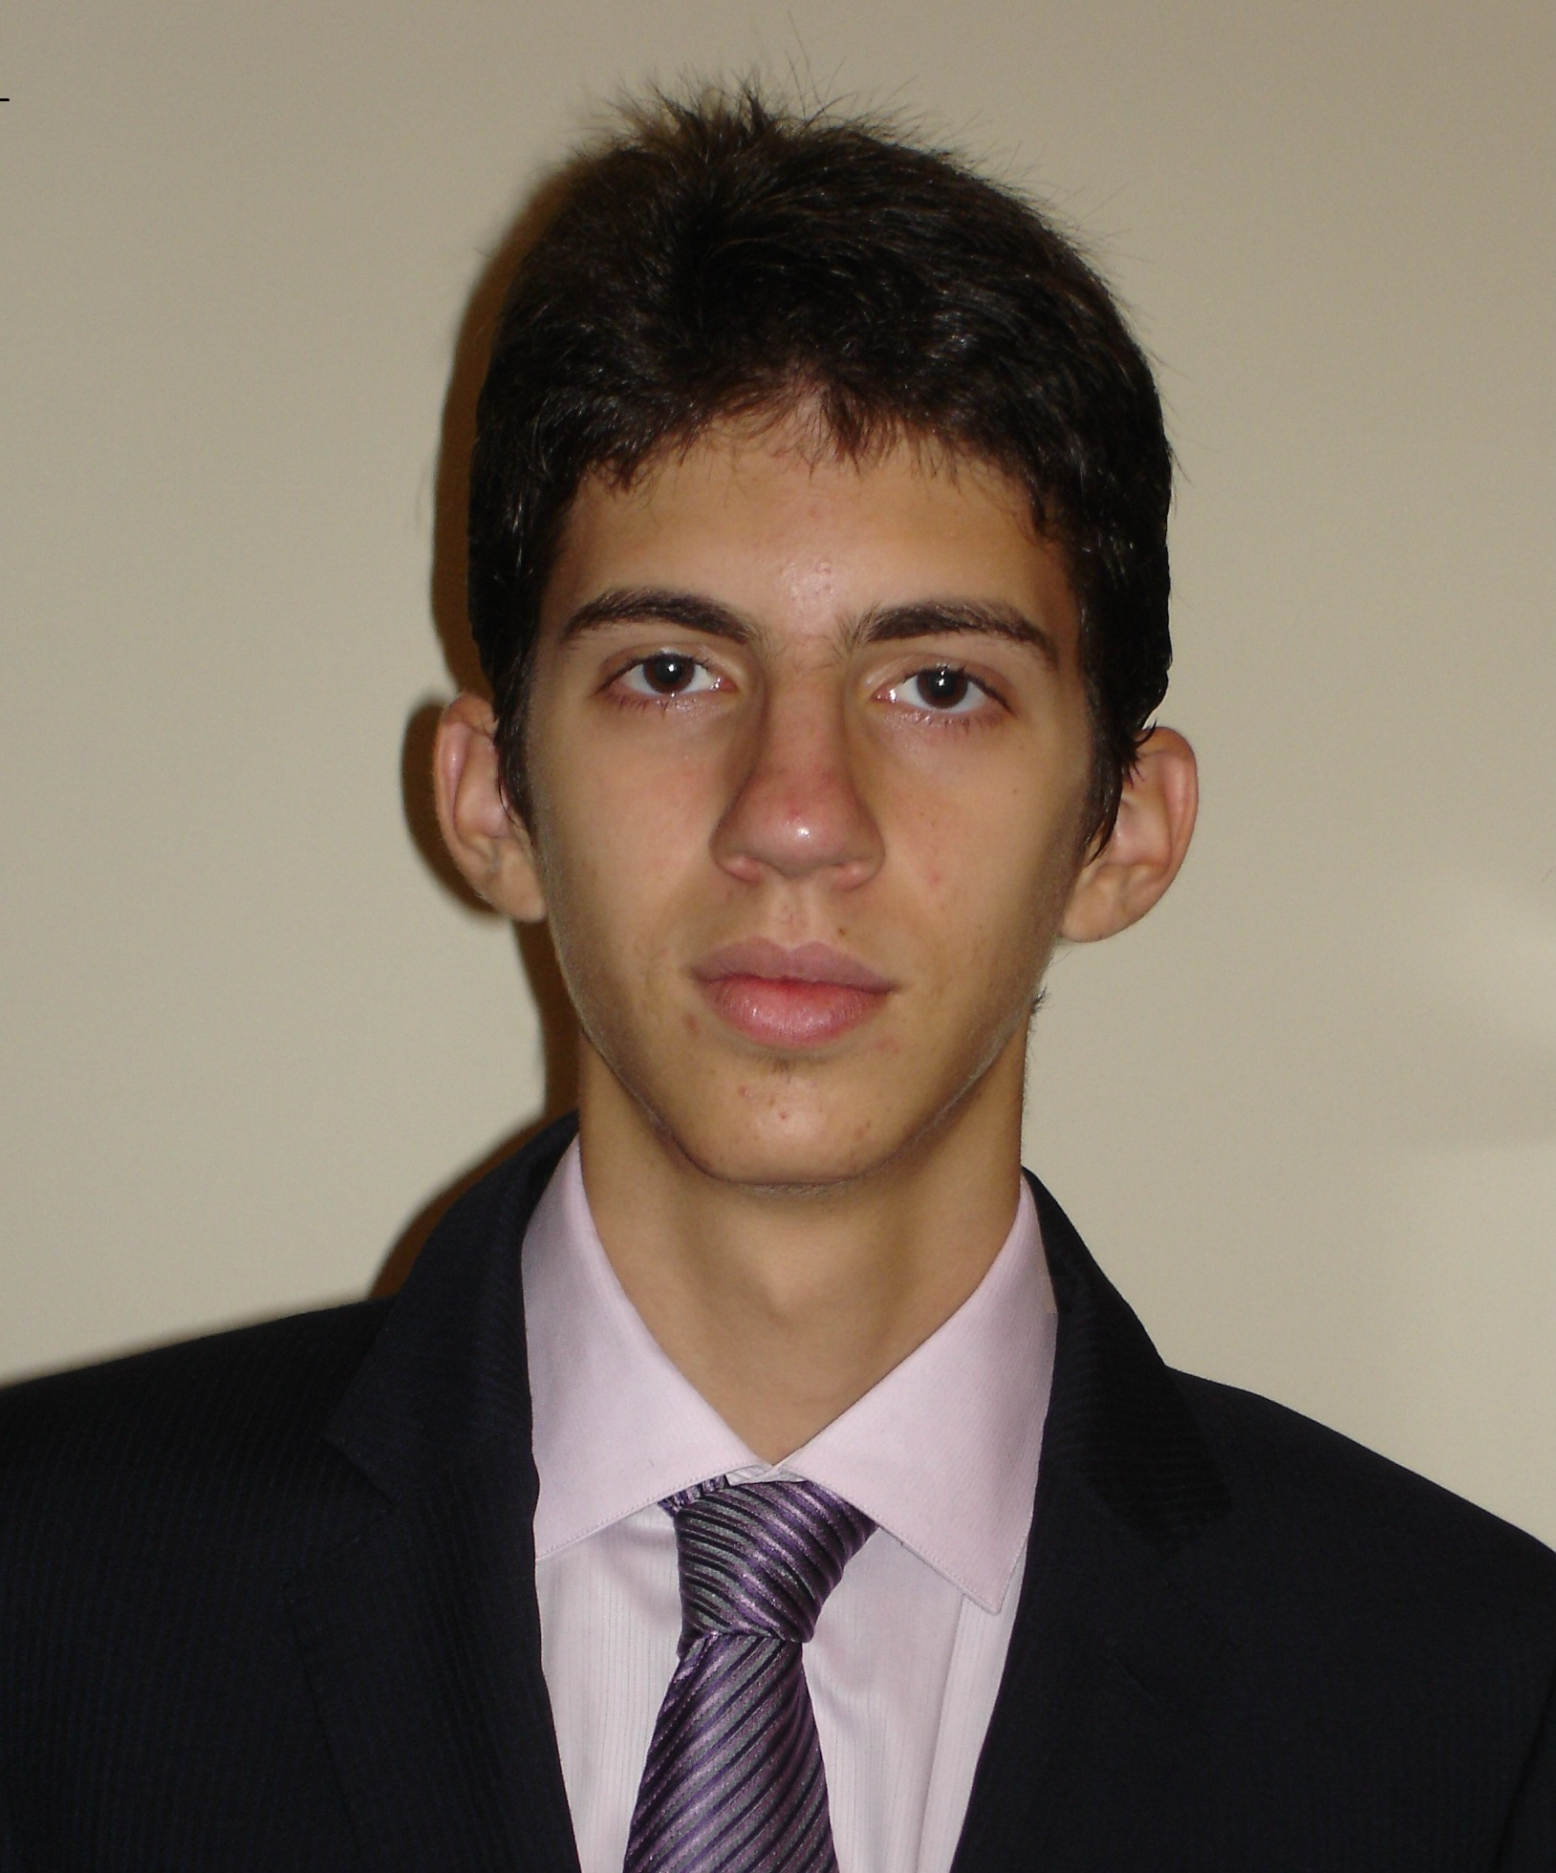
noisyR: enhancing biological signal in sequencing datasets by characterizing random technical noise
Ilias Moutsopoulos, Lukas Maischak, Elze Lauzikaite, Sergio Vasquez Urbina, Eleanor Williams, Hajk-Georg Drost, Irina Mohorianu*
Ilias Moutsopoulos – im383@cam.ac.uk
Research Assistant – Bioinformatician
Core Bioinformatics group (Mohorianu group)
Wellcome-MRC Cambridge Stem Cell Institute

Slide 2
Noise is an intrinsic feature of biological systems, which is amplified by the process of sequencing
Sequencing technologies are constantly improving and increasing in throughput
Low-level expression variations are an intrinsic characteristic of next generation sequencing
At low abundance, read localisation will inevitably vary
Low expression, random distribution
S1
S2
High expression, increased consistency
S1
S2

Slide 3

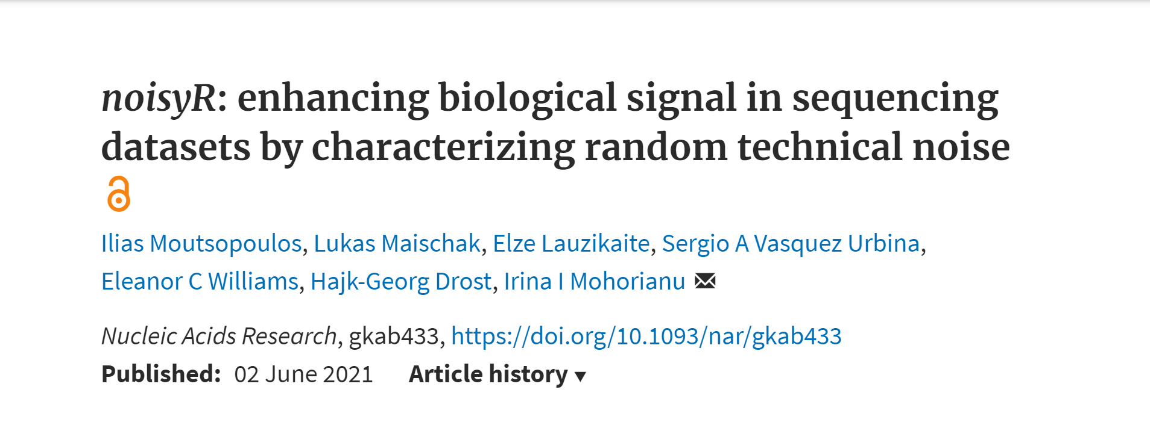
The noisyR paper presents a newly developed noise filter for next generation sequencing data
Consistent reduction of random background noise is still challenging
Meaningful biological signal can be masked by the presence of noise
Different downstream analysis methods often lead to incompatible results and conclusions

Slide 4
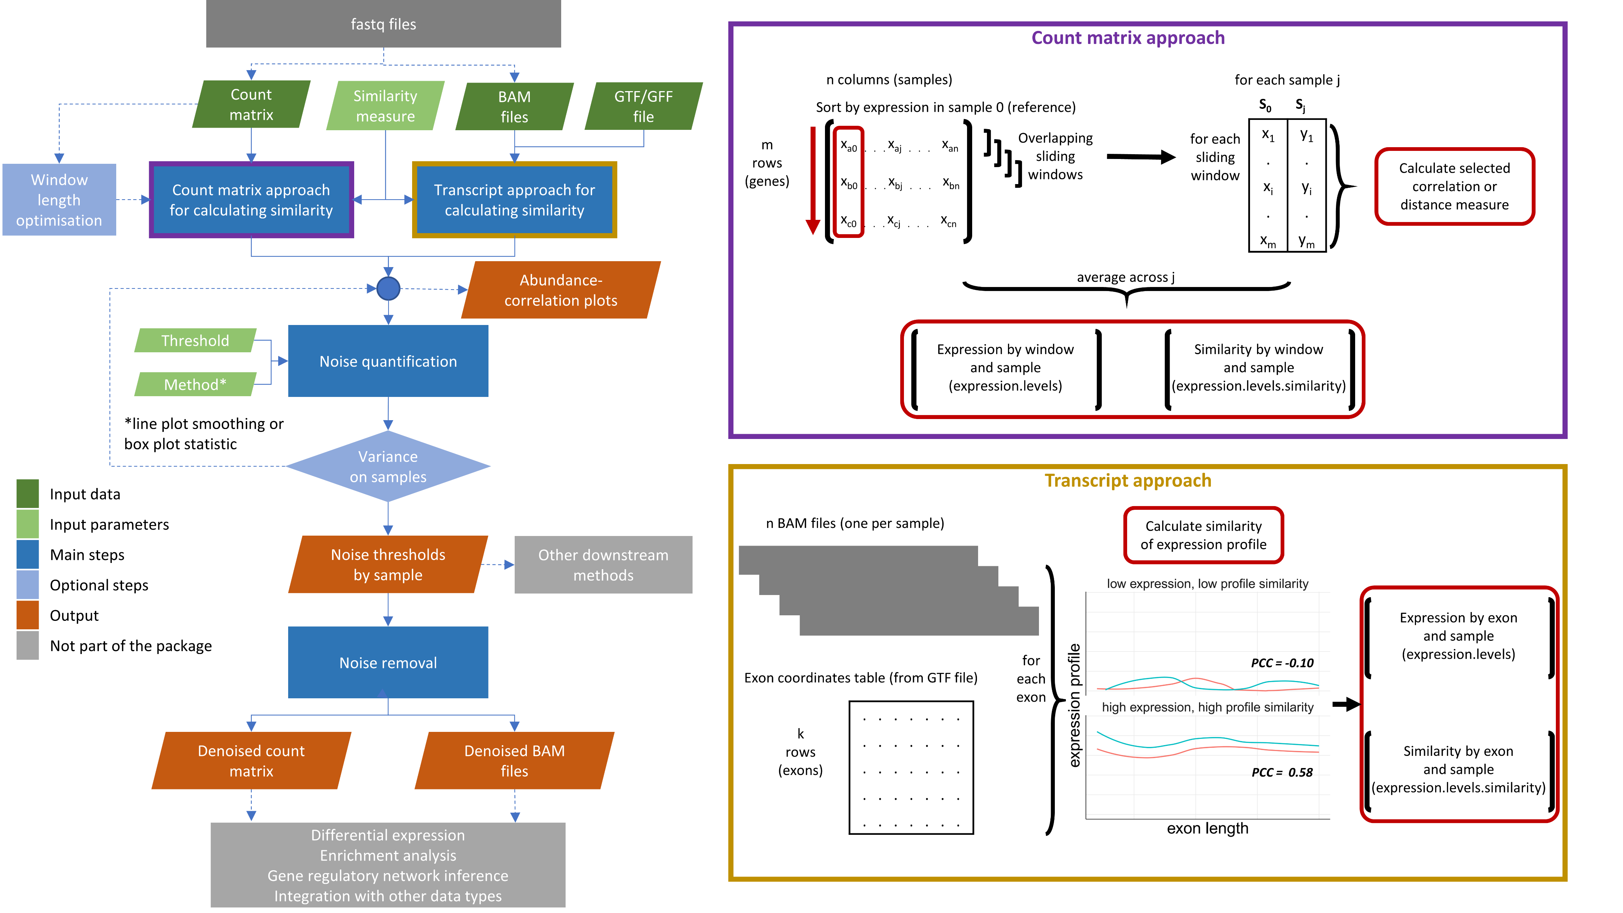

Two approaches depending on the input data
Low expression, random distribution
S1
S2
High expression, increased consistency
S1
S2
The transcript approach uses the alignment (BAM) files
High computation resources
Significantly slower (usually hours)
More precise results
The count matrix approach only uses the total expression
Low computation resources
Very fast (a few seconds/minutes)
Rough results

Slide 5

The software is available as an R package and structured so that little expertise is required to use it
The noisyR package is conceptually broken down into 3 main steps:
Noise Identification (2 approaches)
Noise Quantification
Noise Removal
The “black-box” function noisyr can be used to run the pipeline end-to-end
Parameters can be defaults, user-defined, or optimised at each step, even when running the full pipeline
CRAN: https://cran.r-project.org/package=noisyr
Github: https://github.com/Core-Bioinformatics/noisyR

Slide 6
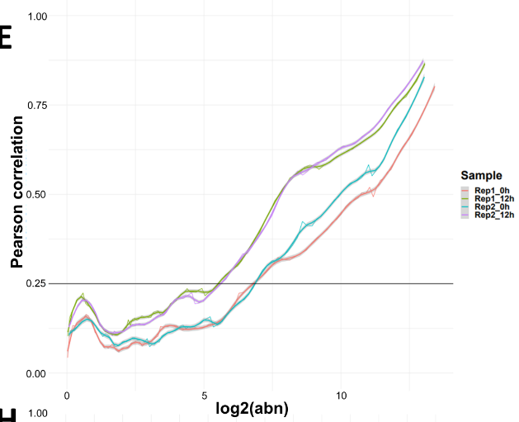
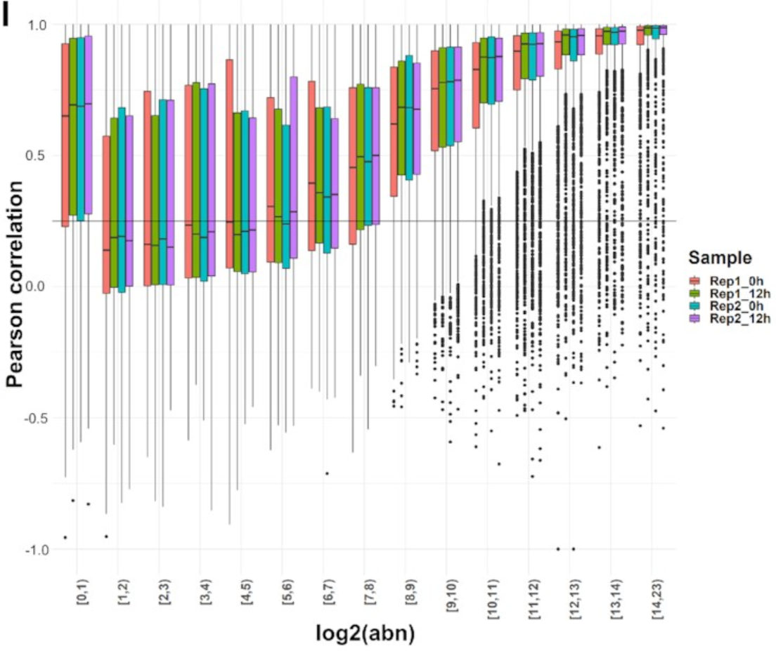
A relationship between abundance and correlation is used to infer a noise threshold
Both approaches produce the same output
Both use a similarity metric
They evaluate sample consistency
Transcript approach calculates per gene, count matrix uses windows
Bulk data from Yang et al (2019) https://doi.org/10.1016/j.cels.2019.03.012

Slide 7
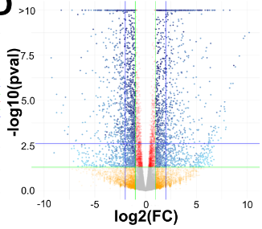
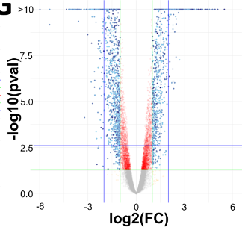
In bulk mRNA-Seq data, noise removal increases the convergence between analysis methods
The number of DE genes is reduced
Potential false positives are greatly reduced

Slide 8
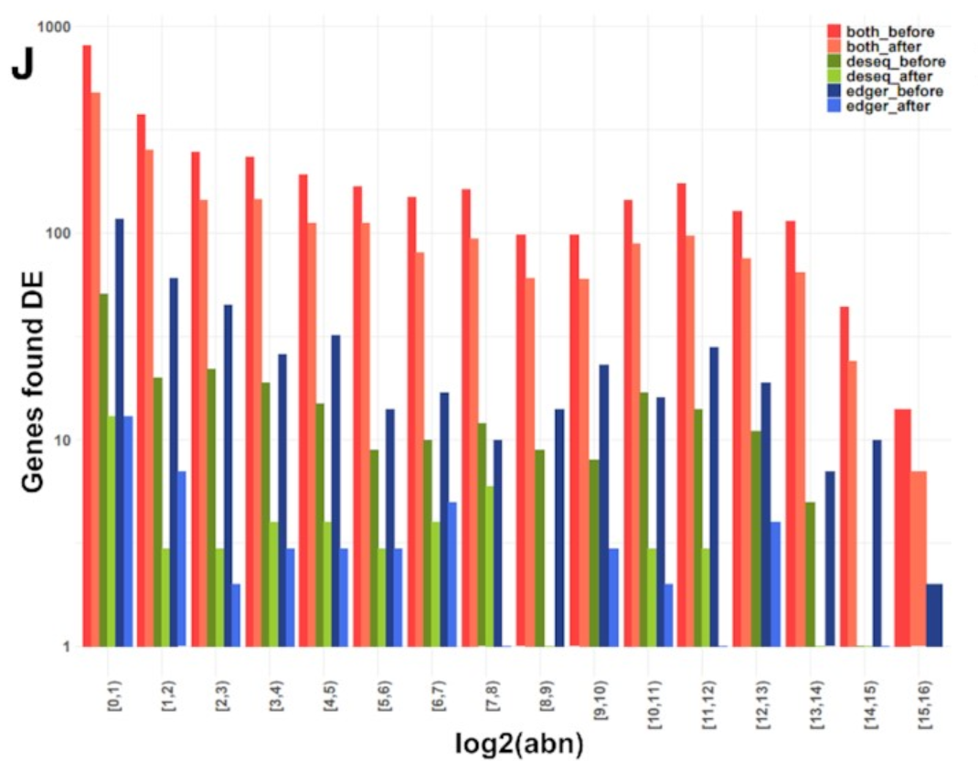
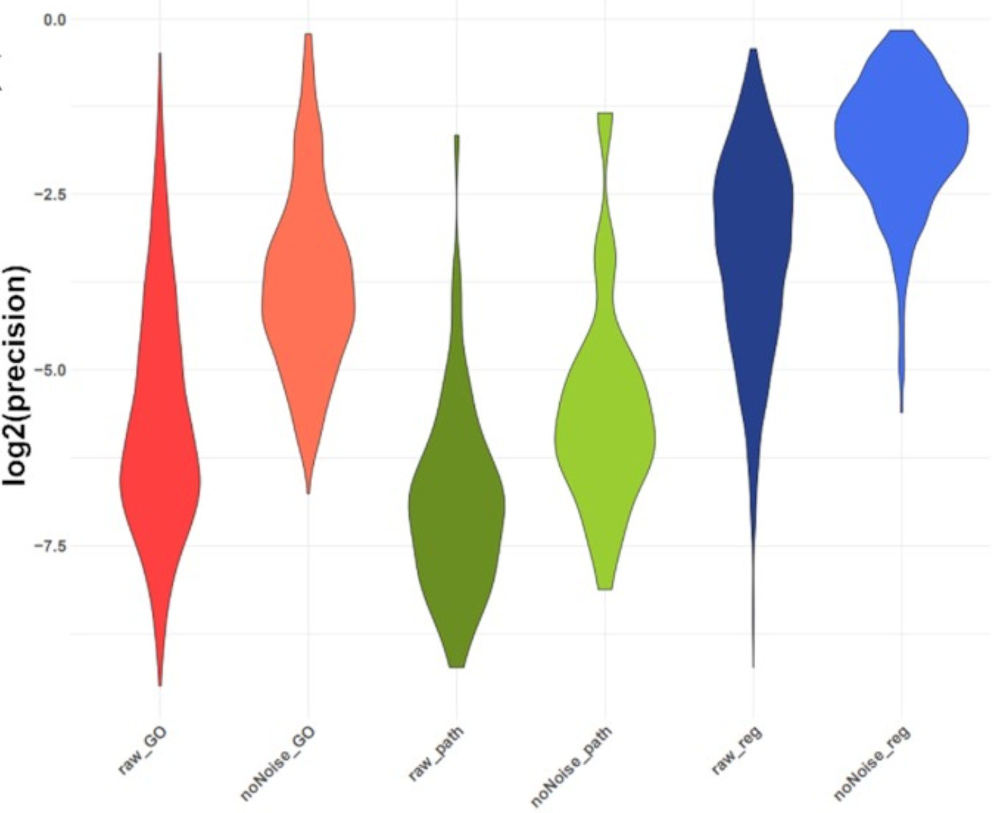
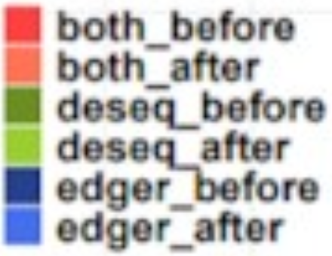
In bulk mRNA-Seq data, noise removal increases the convergence between analysis methods
Analysis methods converge
Interpretation is closer to the biological truth
edgeR: McCarthy et al (2012) https://doi.org/10.1093/nar/gks042
DESeq2: Love et al (2014) https://doi.org/10.1186/s13059-014-0550-8

Slide 9
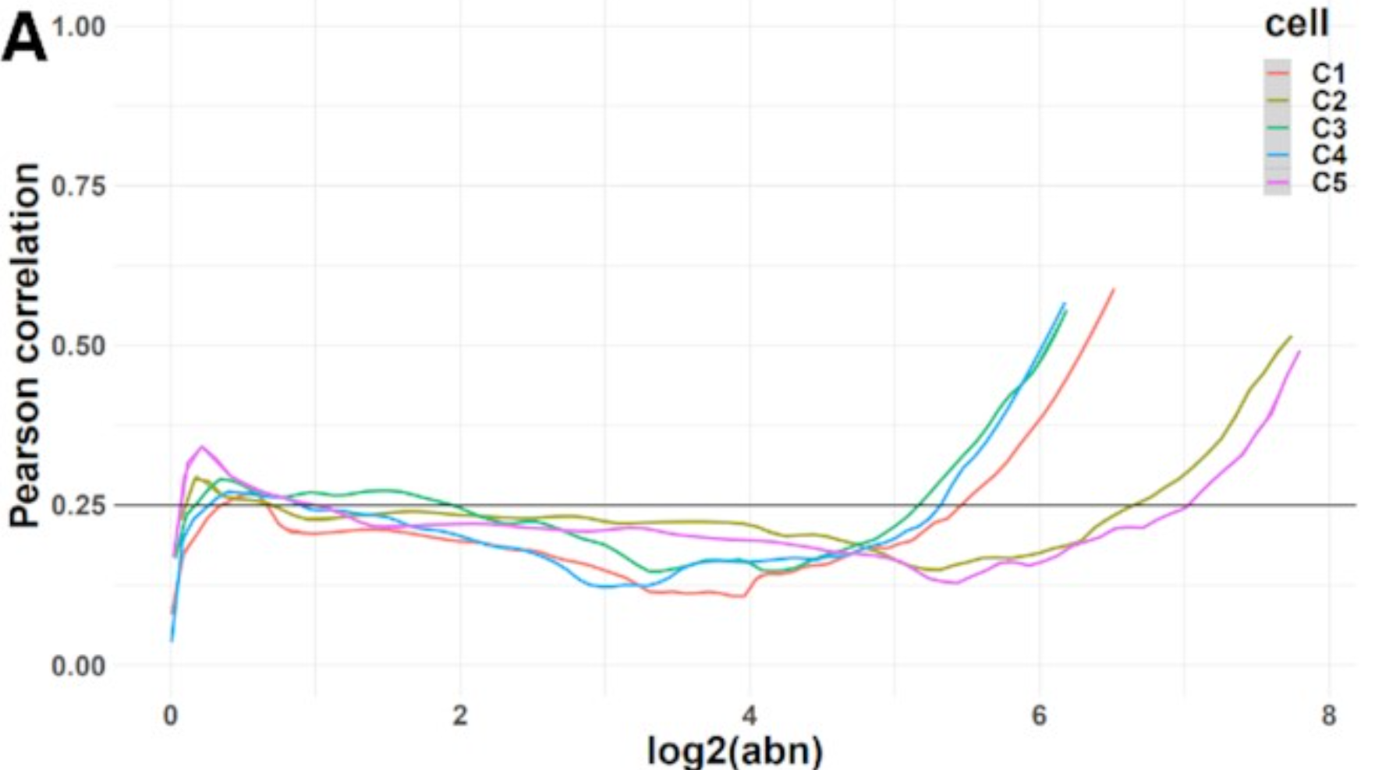
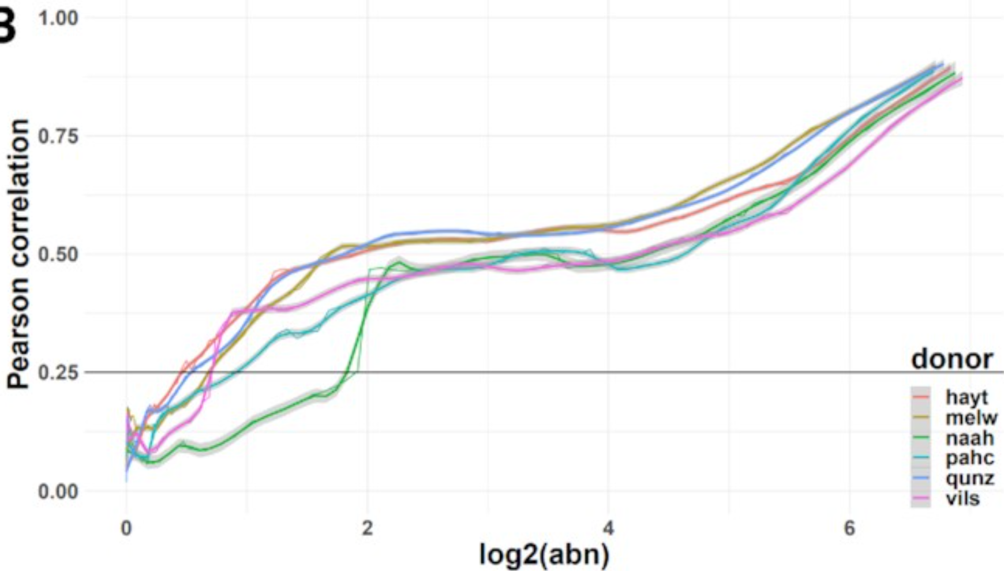
noisyR is a universal approach that can be applied to other types of sequencing data
On single-cell (SmartSeq2) data
Used pseudo-samples to increase consistency
Grouping according to experimental design
Working on a similar approach for 10x data
Have illustrated the approach to improve the prediction of micro-RNA targets in plants (Degradome data)
Will adapt the approach for epigenetic data
Single-cell data from Cuomo et al (2020) https://doi.org/10.1038/s41467-020-14457-z

Slide 10





Thank you for your attention!
Irina Mohorianu
Hajk-Georg Drost
Elze Lauzikaite
Eleanor Williams
Lukas Maischak
Sergio Vasquez Urbina
Alex Calderwood
Yu Zhang
Arash Shahsavari
Andi Munteanu
This work was funded by the Wellcome-MRC Cambridge Stem Cell Institute

Slide 11
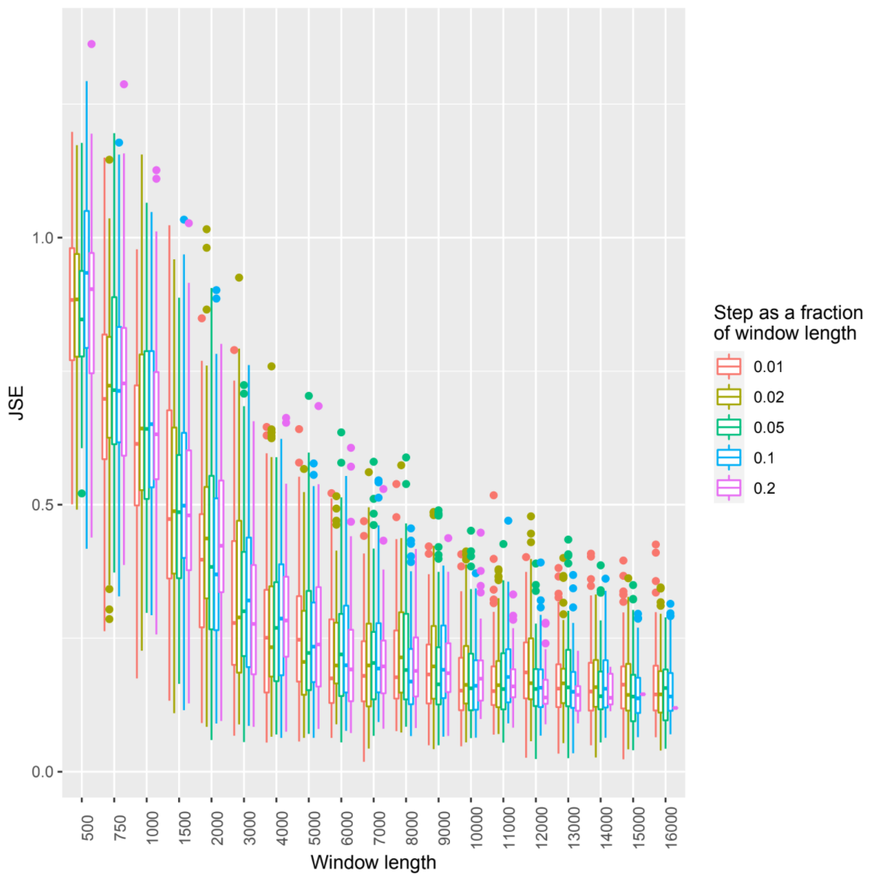
approach | method | similarity.thresh | abn.thresh.min | abn.thresh.mean | abn.thresh.coef.var | abn.thresh.max
Density_based_ fixed_threshold | No_ normalisation | N/A | 299.00 | 299.00 | 0.00 | 299.00
Density_based_ fixed_threshold | RPM_ normalisation | N/A | 298.00 | 298.00 | 0.00 | 298.00
Density_based_ fixed_threshold | Quantile_ normalisation | N/A | 296.00 | 296.00 | 0.00 | 296.00
Line_plot | No_smoothing | 0.25 | 17.10 | 59.06 | 0.58 | 127.25
Line_plot | loess10_smoothing | 0.25 | 16.84 | 58.66 | 0.60 | 133.97
Line_plot | loess25_smoothing | 0.25 | 16.84 | 58.93 | 0.62 | 137.50
Line_plot | loess50_smoothing | 0.25 | 19.13 | 61.51 | 0.71 | 165.21
Boxplot | Median | 0.25 | 18.38 | 60.13 | 0.57 | 128.00
Boxplot | IQR | 0.25 | 18.38 | 61.41 | 0.57 | 137.19
Boxplot | Quant5 | 0.25 | 18.38 | 61.41 | 0.57 | 137.19
Window length optimization
Calculate similarity matrix for a range of windows
Average correlation of each window across samples
Jensen-Shannon divergence with uniform distribution
T-test to determine stability
Determining the noise threshold
Calculate similarity matrix
Use a range of similarity thresholds and methods
Calculate the coefficient of variation across samples
Pick the combination with the lowest variation

